Slide 1





HeartPrint: Passive Heart Sounds Authentication Exploiting In-Ear Microphones
Yetong Cao∗, Chao Cai†, Fan Li∗, Zhe Chen‡, Jun Luo§
*Beijing Institute of Technology, China
†Huazhong University of Science and Technology, China
‡China-Singapore International Joint Research Institute, China §Nanyang Technological University, Singapore
INFOCOM 2023

Slide 2
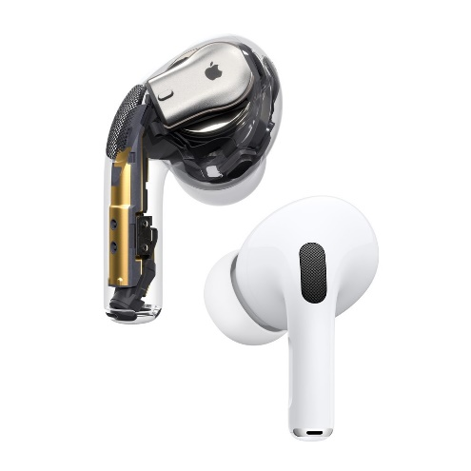
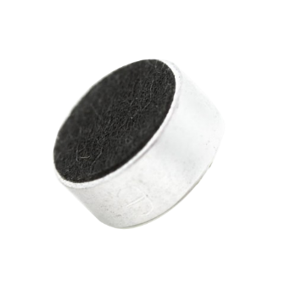
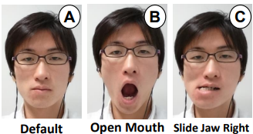
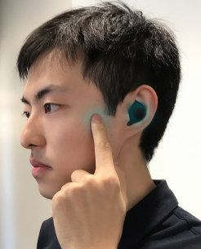
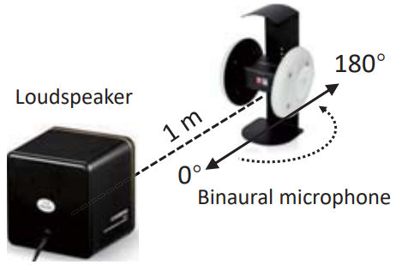
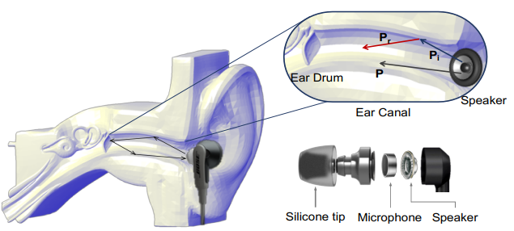
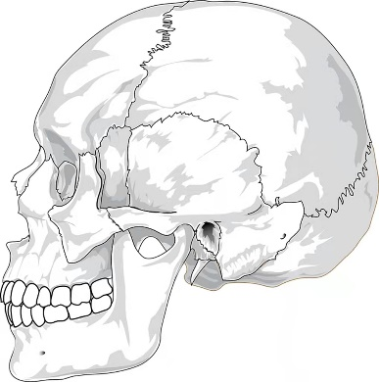
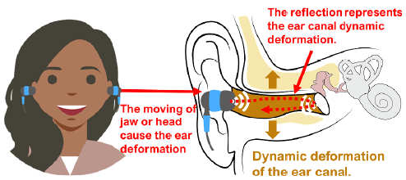
Background
ANC earphones with in-ear microphones (IEMs) are booming.
Acoustic Sensing
IEMs
Earphone authentication methods hamper the normal function of earphones or cause inconvenience to users.
Speaker occupation
Tooth occlusion
Speaker occupation & jaw movement

Slide 3





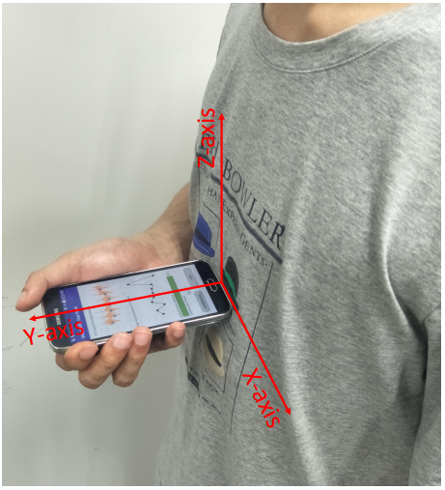
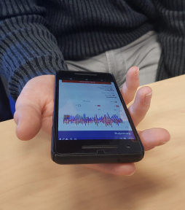
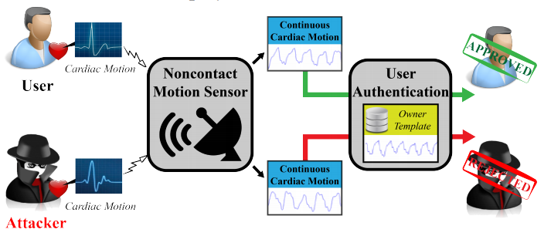

Existing Works
Heart-based biometrics has emerged as a popular authentication method.
Unique
Measurable
Nonvolitional
Secure
Liveness
Existing approaches are limited.
Require user efforts
Rely on special hardware
Can we reusing the IEMs of ANC earphones to capture the unique and fine-grained heart sounds (PCGs) as biometrics to enable pure passive user authentication?

Slide 4
Basic Idea
Body asymmetry patterns
Left and right path are different
Bone-conduction patterns
Bone structures
Bone densities
Bone-tissue ratios
Heart properties
Geometric shape
Volume
Moving dynamics

Slide 5
Basic Idea

Slide 6

Basic Idea
Wide availability
Ubiquitous deployability
Transparent operations

Slide 7
Feasibility Study
Left
Ear
Right
Ear
User 1
User 2
User 3
User 4
Conclusion
Different users exhibit clear distinctions in bone-conducted PCGs.
Individual users also exhibit discernible body asymmetry patterns.

Slide 8
Feasibility Study
Left
Ear
Right
Ear
User 4
User 4
User 4
Session 2
Session 3
Session 1
Conclusion
The same users hold consistent patterns across different sessions.

Slide 9
Feasibility Study
t-SNE projection of CWT for four users across ten sessions
The binaural bone-conducted PCGs contain sufficient biometrics that is unique across users and remains consistent over time.

Slide 10
HeartPrint
Challenge 1: How to remove interference without impairing the general usage of earphones?
Challenge 3: How to address biometrics shift over time?
Challenge 2: How to extract unique and secure biometric information?

Slide 11



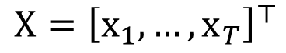

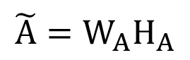
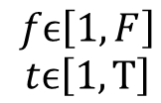
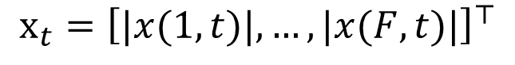
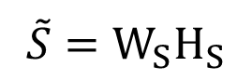
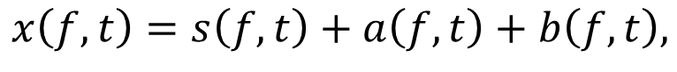

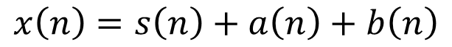


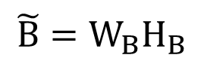


Interference Elimination
Interference filtering
Background audio
Body sounds
160Hz low-pass filter
Interference eliminating based on modified Non-negative Matrix Factorization
Signal decomposition
STFT
$$fϵ\left[1,F\right]$$
$$tϵ\left[1,T\right]$$
$$x\left(n\right)=s\left(n\right)+a\left(n\right)+b\left(n\right)$$
$$x\left(f,t\right)=s\left(f,t\right)+a\left(f,t\right)+b\left(f,t\right),$$
$$X={\left[x_{1},…,x_{T}\right]}^{⊤}$$
$$S$$
$$A$$
$$B$$
$$x_{t}={\left[|x(1,t)|,…,|x(F,t)|\right]}^{⊤}$$
Traditional NMF:
$${\tilde{S}=W}_{S}H_{S}$$
$$X≈\tilde{X}=WH$$
Traditional NMF can not handle the wide spectrum of interference.
$$W={\left[W_{S},W_{A},W_{B}\right]}^{⊤}$$
$${\tilde{A}=W}_{A}H_{A}$$
$$H={\left[H_{S},H_{A},H_{B}\right]}^{⊤}$$
$${\tilde{B}=W}_{B}H_{B}$$

Slide 12

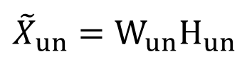

Interference Elimination
Interference filtering
Background audio
Body sounds
160Hz low-pass filter
Interference eliminating based on modified Non-negative Matrix Factorization
Signal decomposition
STFT
$$fϵ\left[1,F\right]$$
$$tϵ\left[1,T\right]$$
$$x\left(n\right)=s\left(n\right)+a\left(n\right)+b\left(n\right)$$
$$x\left(f,t\right)=s\left(f,t\right)+a\left(f,t\right)+b\left(f,t\right),$$
$$X={\left[x_{1},…,x_{T}\right]}^{⊤}$$
$$S$$
$$A$$
$$B$$
Modified NMF:
$${\tilde{S}=W}_{S}H_{S}$$
$$X≈\tilde{X}=WH$$
$$W={\left[W_{S},W_{A},W_{B},W_{un}\right]}^{⊤}$$
$${\tilde{A}=W}_{A}H_{A}$$
$${{\tilde{X}}_{un}=W}_{un}H_{un}$$
$$W={\left[W_{S},W_{A},W_{B}\right]}^{⊤}$$
$$H={\left[H_{S},H_{A},H_{B},H_{un}\right]}^{⊤}$$
$${\tilde{B}=W}_{B}H_{B}$$
$$H={\left[H_{S},H_{A},H_{B}\right]}^{⊤}$$

Slide 13
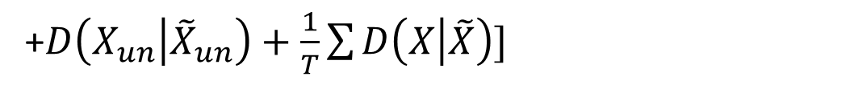
Interference Elimination
Interference filtering
Background audio
Body sounds
160Hz low-pass filter
Interference eliminating based on modified Non-negative Matrix Factorization
Signal decomposition：
STFT
$$fϵ\left[1,F\right]$$
$$tϵ\left[1,T\right]$$
$$x\left(n\right)=s\left(n\right)+a\left(n\right)+b\left(n\right)$$
$$x\left(f,t\right)=s\left(f,t\right)+a\left(f,t\right)+b\left(f,t\right),$$
$$X={\left[x_{1},…,x_{T}\right]}^{⊤}$$
$$S$$
$$A$$
$$B$$
Modified NMF:
$$X≈\tilde{X}=WH$$
$$\min_{W,H}[{η_{S}D\left(S | \tilde{S}\right)+η_{A}D\left(A | \tilde{A}\right)+η_{B}D\left(B | \tilde{B}\right)}$$
$$W={\left[W_{S},W_{A},W_{B},W_{un}\right]}^{⊤}$$
+$D\left(X_{un} | {\tilde{X}}_{un}\right)+\frac{1}{T}\sum{D\left(X | \tilde{X}\right)]}$
$$H={\left[H_{S},H_{A},H_{B},H_{un}\right]}^{⊤}$$

Slide 14
Interference Elimination
Interference filtering
Background audio
Body sounds
160Hz low-pass filter
Interference eliminating based on modified Non-negative Matrix Factorization
Signal decomposition
Bone-conducted PCGs reconstruction
Identify bone-conducted PCGs based on cosine distance
Inverse STFT
Interference elimination

Slide 15
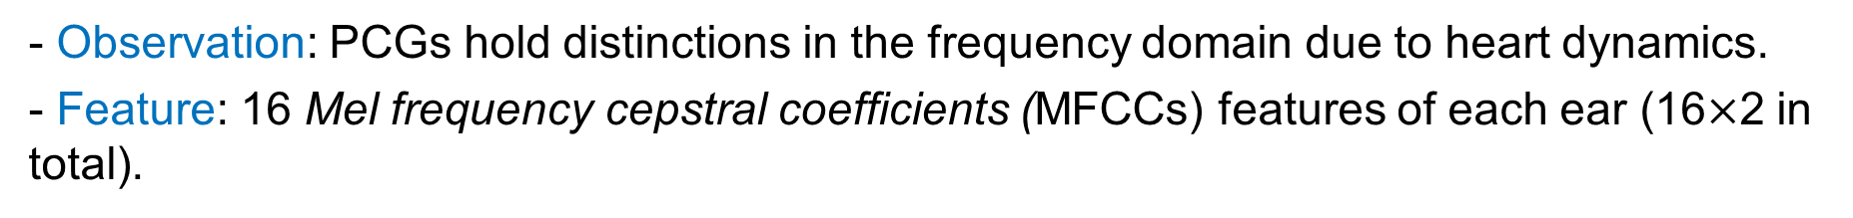
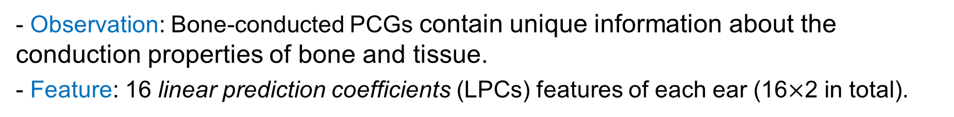
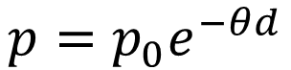
Representation Extraction
Sound wave propagation model
Decay property
Decayed sound pressure
$$p=p_{0}e^{−θd}$$
Propagation distance
Sound source
Heart motion feature
- Observation: PCGs hold distinctions in the frequency domain due to heart dynamics.
- Feature: 16 Mel frequency cepstral coefficients (MFCCs) features of each ear (16$×$2 in total).
Body conduction feature
- Observation: Bone-conducted PCGs contain unique information about the conduction properties of bone and tissue.
- Feature: 16 linear prediction coefficients (LPCs) features of each ear (16$×$2 in total).

Slide 16
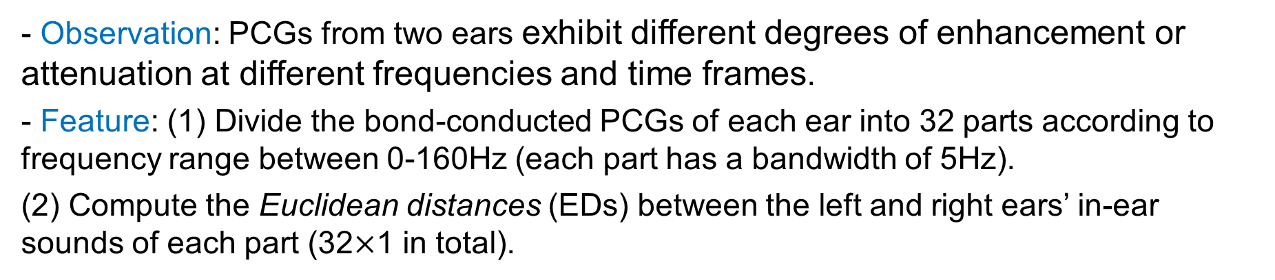
Representation Extraction
Body asymmetry feature
- Observation: PCGs from two ears exhibit different degrees of enhancement or attenuation at different frequencies and time frames.
- Feature: (1) Divide the bond-conducted PCGs of each ear into 32 parts according to frequency range between 0-160Hz (each part has a bandwidth of 5Hz).
(2) Compute the Euclidean distances (EDs) between the left and right ears’ in-ear sounds of each part (32$×$1 in total).
Final biometrics
LPCs (left ear)
LPCs (right ear)
EDs
MFCCs (left ear)
MFCCs (right ear)

Slide 17
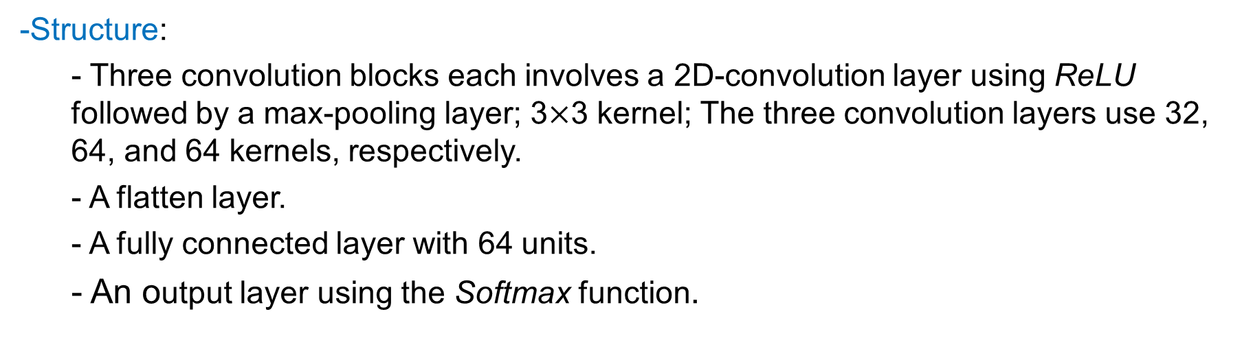
Authentication Decision
CNN-based deep learning framework
-Structure:
- Three convolution blocks each involves a 2D-convolution layer using ReLU followed by a max-pooling layer; 3$×$3 kernel; The three convolution layers use 32, 64, and 64 kernels, respectively.
- A flatten layer.
- A fully connected layer with 64 units.
- An output layer using the Softmax function.

Slide 18
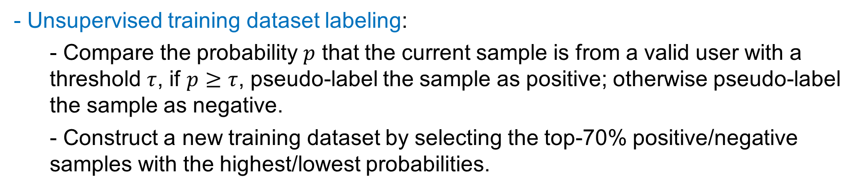
Authentication Decision
Continual learning processor
- Basic idea: Protect the performance of the existing CNN-based model while modifying the elastic weight consolidation (EWC) method to adapt the CNN-based model to new training datasets.
- Unsupervised training dataset labeling:
- Compare the probability $p$ that the current sample is from a valid user with a threshold $τ$, if $p≥τ$, pseudo-label the sample as positive; otherwise pseudo-label the sample as negative.
- Construct a new training dataset by selecting the top-70% positive/negative samples with the highest/lowest probabilities.

Slide 19
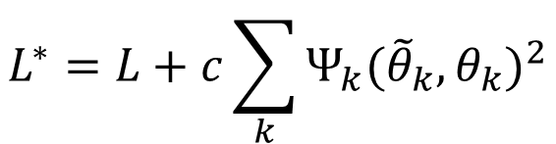
Authentication Decision
Continual learning processor
- Basic idea: Protect the performance of the existing CNN-based model while modifying the elastic weight consolidation (EWC) method to adapt the CNN-based model to new training datasets
- Unsupervised training dataset labeling
- CNN model updating using EWC:
Traditional EWC loss
$$L^{∗}=L+c\sum_{k}{Ψ_{k}({{\tilde{θ}}_{k},θ}_{k})^{2}}$$
Modified loss function:
Surrogate loss

Slide 20
Authentication Decision
Sampling controller
- Build a sampling function of interference intensity.

Slide 21
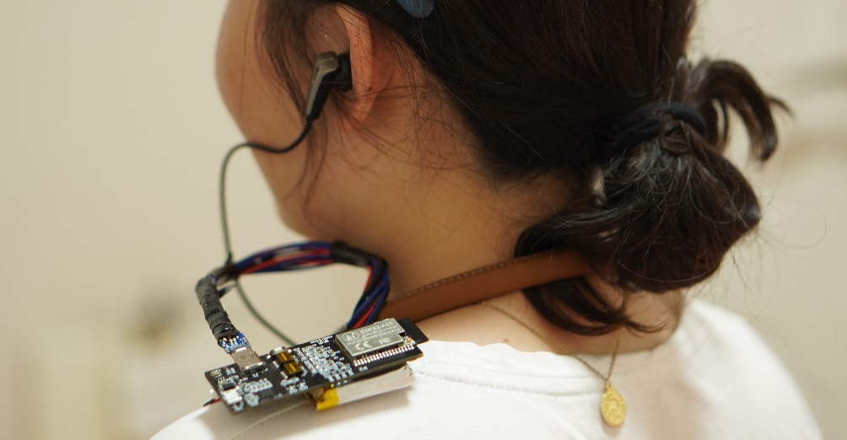
Implementation
Prototype
- ANC earphones with IEMs
- Sensing board
Data collection
- 45 participants (26 males and 19 females)
- Three months
- Each participant records 130-200 minutes
- Controlled lab room, home, and a park
- 24-hour evaluation
- Key algorithm evaluation
- Impact factor evaluation
- Long-term evaluation

Slide 22
Evaluation: Overall Performance
Replay attack:
- Consider one participant as a valid user and the remaining participants as random attackers.
Average FAR 1.6%
Average FRR 1.8%

Slide 23
Evaluation: Overall Performance
Replay attack:
- Use medical records (i.e., chest PCG gathered via electronic stethoscopes) and a medical human silicone simulator to forge binaural bone-conducted PCGs.
Average FAR 2.3%

Slide 24
Evaluation: Key Algorithms
Interference elimination:
- Case i: IS=audio, IE=without
- Case ii: IS=motion, IE=without
- Case iii: IS=audio, IE=with
- Case iv: IS=motion, IE=without
Continual learning:
- Conduct experiment for 12 weeks.
FAR and FRR below 2.5%
in 12 weeks

Slide 25
Evaluation：Practical Issues
24-hour study:
- Conduct experiment for 24 hours (contains daily activities)
Earphone wearing states:
 | 0° | 45° | 90°
2mm | FAR=1.9% FRR=2.2% | FAR=2.1% FRR=2.5% | FAR=2.0% FRR=2.2%
4mm | FAR=1.6% FRR=1.9% | FAR=1.6% FRR=1.9% | FAR=1.6% FRR=1.9%
6mm | FAR=1.4% FRR=1.7% | FAR=1.4% FRR=1.8% | FAR=1.4% FRR=1.7%
8mm | FAR=1.4% FRR=1.6% | FAR=1.4% FRR=1.6% | FAR=1.4% FRR=1.6%
10mm | FAR=1.3% FRR=1.6% | FAR=1.4% FRR=1.6% | FAR=1.4% FRR=1.6%
Average FAR 2.0%
Average FRR 3.8%

Slide 26
Conclusion
We propose a passive user authentication system, HeartPrint, using ANC earphones with IEMs.
HeartPrint exploits the unique binaural bone-conducted PCGs and IEMs.
We present several effective methods to achieve HeartPrint.
Interference elimination based on modified NMF.
Representation extraction, including heart motion feature, body conduction feature, and body asymmetry feature.
User authentication based on CNN-based framework and continue learning technology.
We design prototypes and conduct experiments with 45 participants.
HeartPrint is accurate and can resist various attacks.

Slide 27
Thanks!
Thanks!
Thanks!
&
&
&
Questions
Questions
Questions
Yetong Cao
yetongcao@bit.edu.cn

